Slide 1
Elements of TAS architecture

Slide 2

CI 2.0
TAS Linux Server
TAS 1
TAS 2
TAS 3
...
TAS n
Test Node 1
Test Node 2
Test Node 3
...
Test Node n
Windows Boxes
Device 1
Device 2
Device 3
...
Device n
Physical Devices

Slide 3
COM 1
54321
COM 2
26543
TAS 1
COM 3
TCP/IP
12345
37564
...
COM n
48765

Slide 4
TAS 1
COM 1
12345
54321
TAS 2
COM 2
23456
26543
TAS 3
COM 3
34567
TCP/IP
37564
...
...
TAS n
COM n
45678
48765

Slide 5
COM 1
54321
COM 2
26543
TAS 1
COM 3
TCP/IP
12345
37564
...
COM n
48765

Slide 6


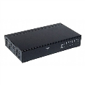





Test Execution
Test Description:
Artifacts
Products
Testing tools
Test script
CI 2.0
TAS 1

Slide 7

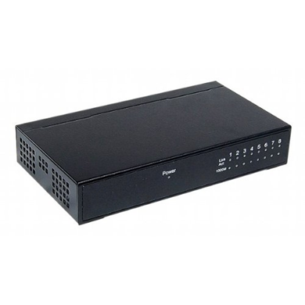
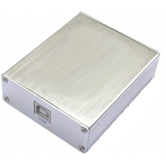
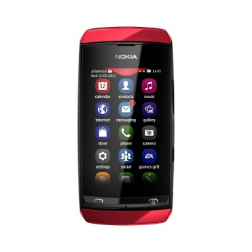
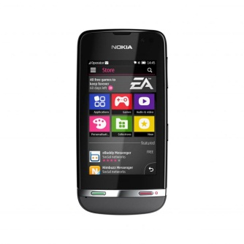
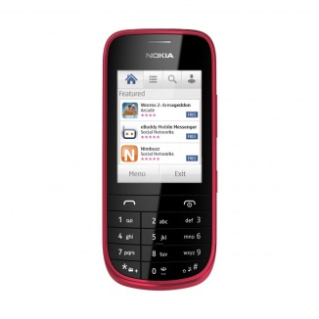

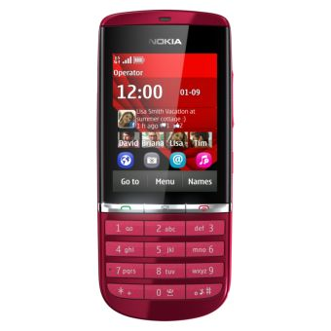
A single test node
Prommer
REBO

